Slide 1
Divide & conquer Merge sort
Name: kenzy Tamer kishk
ID:223005

Slide 2
Table of contents
01
02
03
04
Defintion
Steps of merge sort
example
Analysis

Slide 3
01
Merge sort definition

Slide 4
What is a Merge sort ?
Is an efficient methods for sorting an array of elements it relies on the principles of “divide & conquer”
Where the array is divided into smaller sections, sorted <and then merged back together . This process continues until we sorted the array

Slide 5
02
Steps of merge sort

Slide 6
Here are the steps
Division
Sorting
Merging
We divide the array into halves
We sort the divide halves
We merge the sorted halves in a sorted manner

Slide 7
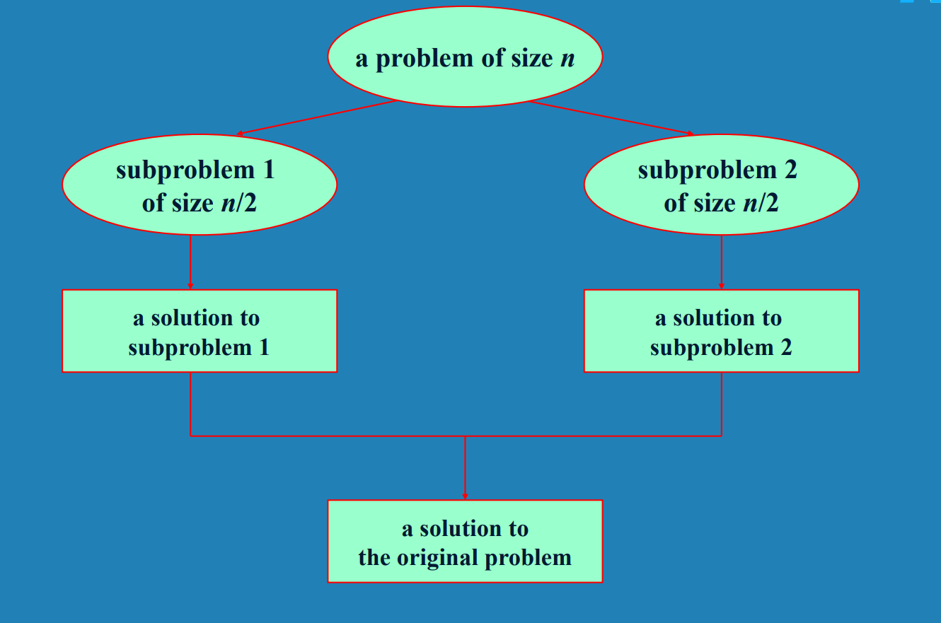

Slide 8
03
Example & implementation

Slide 9
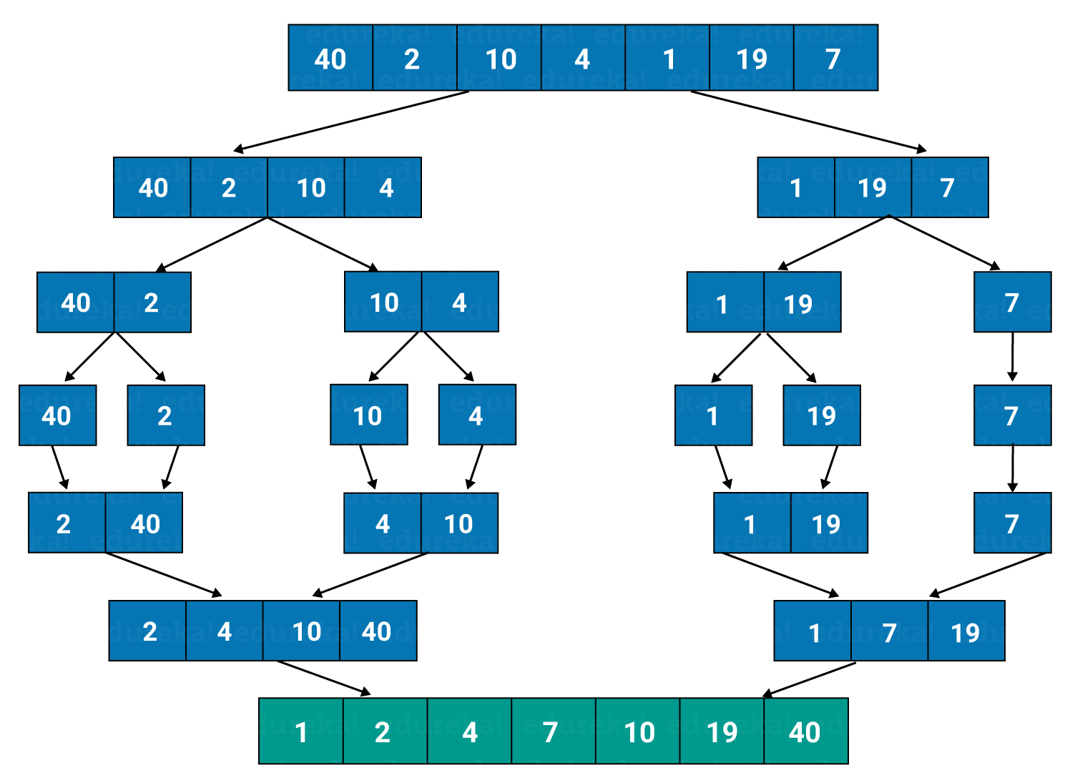
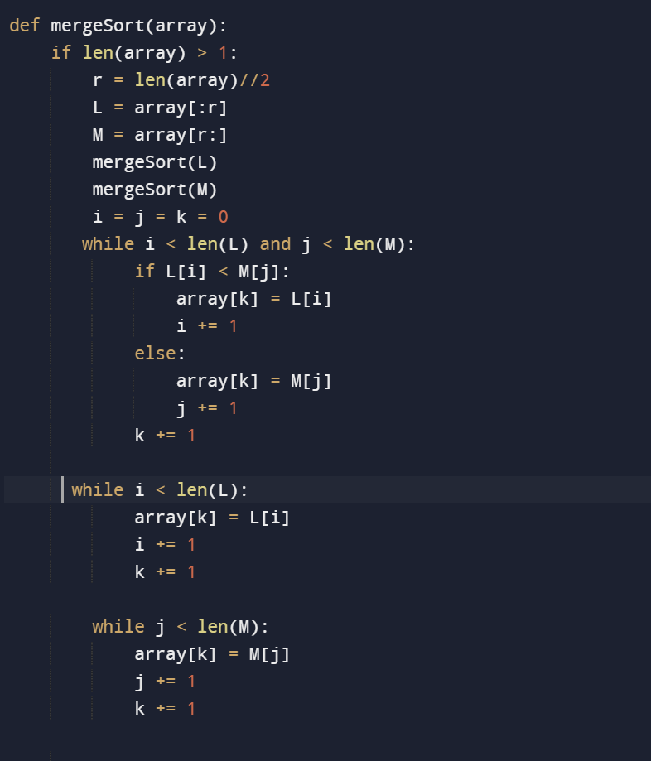

Slide 10
04
Analysis

Slide 11
Analysis
Time Complexity: O(n logn) (in all cases: average, worst, and best)
Space Complexity: 𝑂(𝑛)

